Slide 1
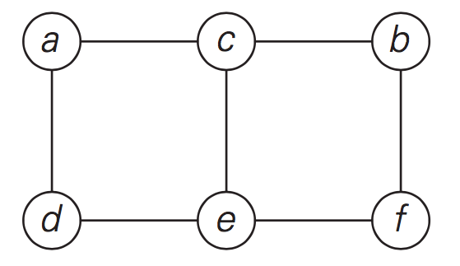
Adjacency Matrix and Adjacency List

Slide 2
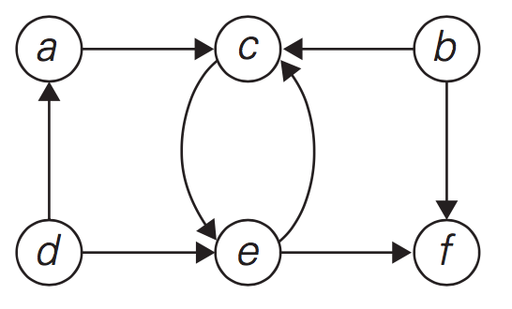
3
5
10
4
20
7
9
1
Adjacency Matrix and Adjacency List

Slide 3
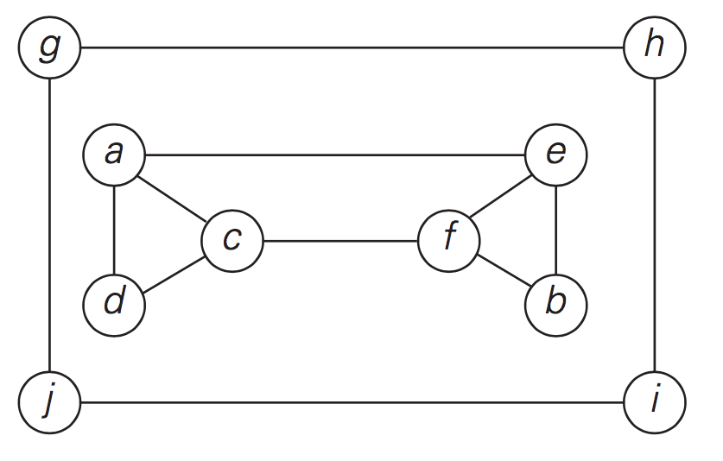
DFS, BFS

Slide 4
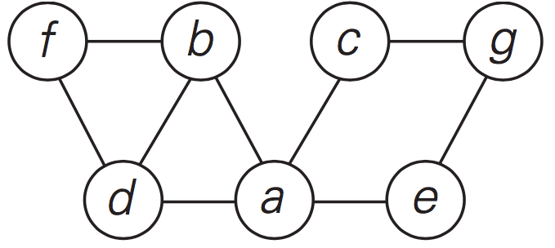
h
j
i
Practice: DFS, BFS

Slide 5
